Slide 1
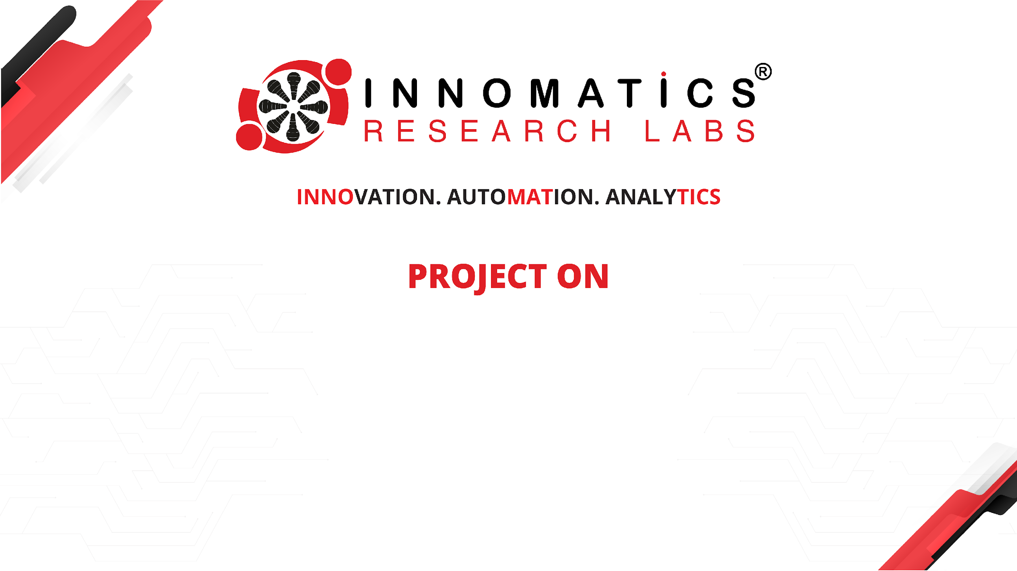
CODE REFACTORING AND BUG FIXING
Ayesha Begum

Slide 2
About me
Ayesha Begum Aspiring Data Scientist
I am a motivated and detail-oriented data scientist currently undergoing training at Innomatics Research Labs, where I am gaining hands-on experience in data science and model building. With a Master’s degree in Statistics from Osmania University, I am passionate about leveraging data to solve complex business challenges and derive meaningful insights. My technical skills include Python, SQL, machine learning, and data analysis, which I apply effectively in developing data-driven solutions.
I pride myself on being an active and agile learner, constantly seeking to enhance my knowledge and skills in the field of artificial intelligence and data science. My strong communication and leadership abilities allow me to collaborate effectively within teams and convey insights clearly to stakeholders. I am eager to contribute my expertise and enthusiasm to innovative projects that harness the power of data.

Slide 3
Project Overview
The objective of this project is to refactor the existing codebase of the Note Taking application to enhance its functionality and user experience. This involves identifying and resolving all bugs present in the current implementation to ensure seamless operation. The application should enable users to easily add new notes, while displaying all pre-existing notes on the same page in the form of an unordered list.
The technology stack utilized for this application includes:
Flask: For building the web application and managing server-side logic.
HTML: For structuring the web pages.
CSS: For styling and enhancing the visual presentation of the application.

Slide 4
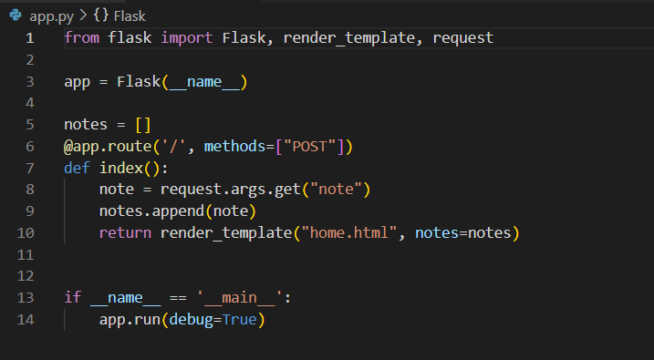
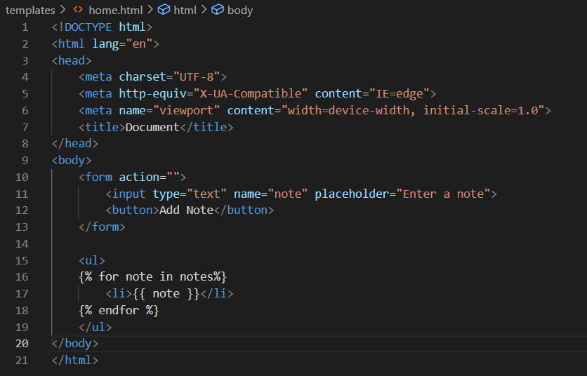
EXISTING CODEBASE
Flask code
HTML code

Slide 5
BUGS IDENTIFIED
BUG-1:
The form tag doesn’t contain the “method” attribute and the “action” attribute is also absent which leads to “Method not allowed” error when the application is in use.

Slide 6
BUGS IDENTIFIED
BUG-2:
The app routing part only accepts the POST requests which results in “Method not allowed” error when the application is used.
BUG-3:
The binding function of the route ‘/’ uses request.args.get() method which accepts the url parameters not the form parameters.

Slide 7
BUG FIXING
BUG-1 can be fixed by using the ‘/’ route in action attribute and ‘post’ value in method attribute in the form tag.
BUG-2 is fixed by using both the ‘POST’ and ‘GET’ methods while using the route.
BUG-3 is solved by using the request.form.get() method in the binding function.
CODE REFACTORING
Code refactoring is the process of restructuring the code without change in it’s functionality.
In order to restructure the additional features are implemented to the HTML template using CSS so the application would be more user friendly.

Slide 8
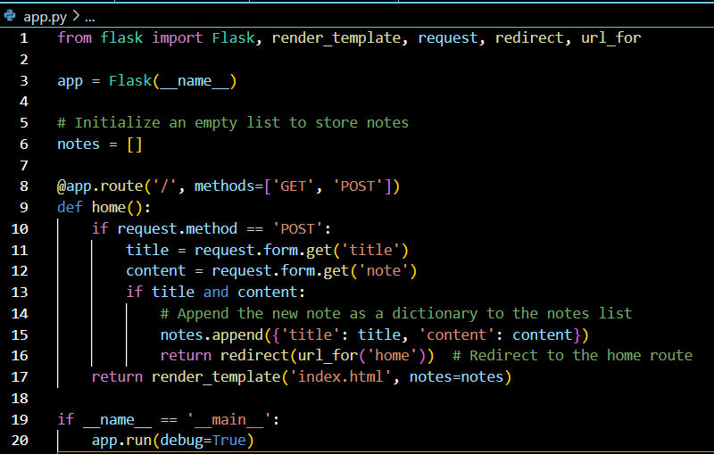
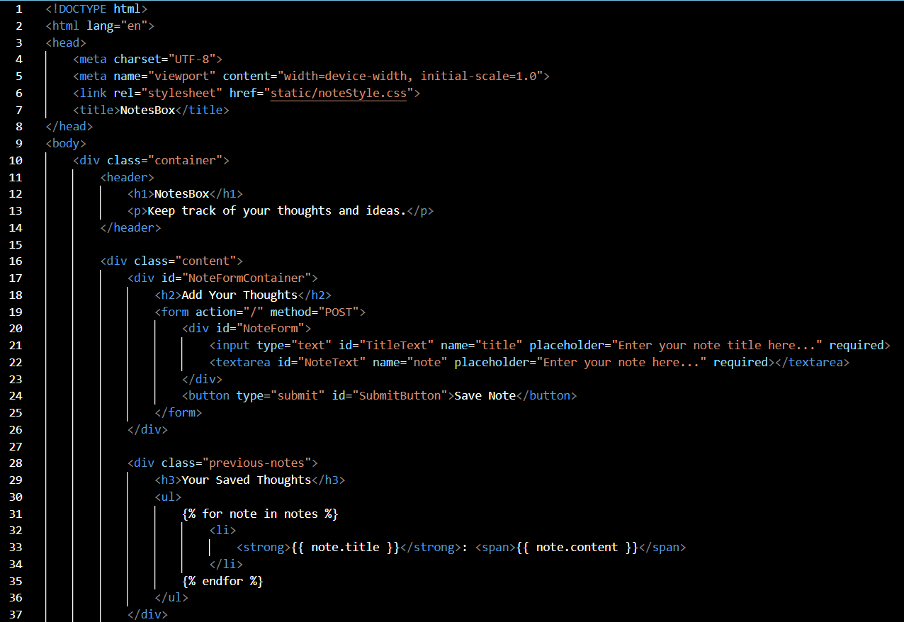
CODE AFTER BUG FIXING
Flask code
HTML code

Slide 9
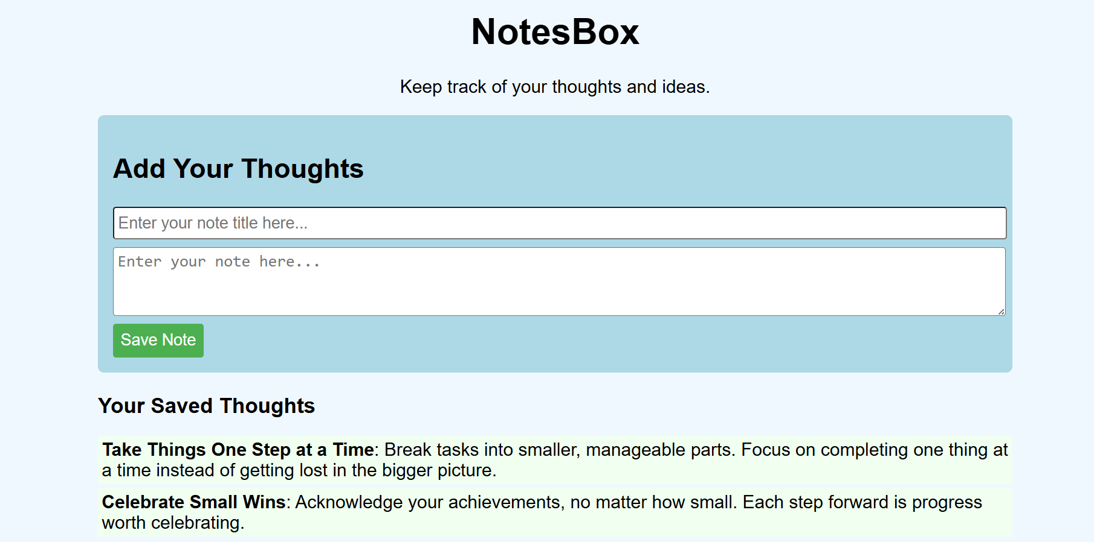
VALIDATION

Slide 10
CONCLUSION
In summary, three bugs were identified and successfully resolved in the codebase without altering the application's existing functionality.
The application, developed using the Flask framework, effectively enables users to add notes with appropriate titles and review their previous entries.
To enhance user experience further, additional functionalities such as the ability to delete and update notes could be integrated.
Implementing these features will not only improve the application's usability but also provide users with greater flexibility in managing their notes, ultimately leading to a more robust and user-friendly application.

Slide 11

THANK YOU

